Slide 1
Group Drumming and Cooperation
Sean McWeeny
Adam Luoma, Yaseen Al-Saleem
February 28th 2023

Slide 2
Synchrony inducing prosocial behaviour
Synchrony (i.e., in-phase & in-time movement with other) facilitates prosocial behaviour
Musically: Infants bouncing in vs. out of time with partner (Cirelli et al., 2014)
Non-musical contexts: Walking in-step(Wiltermuth & Heath, 2009)
Synchrony promotes prosocial behavior above and beyond “coordinated movements” (meta-analysis: Mogan et al., 2017)
Notes:
In time and in phase*** make sure to specify

Slide 3
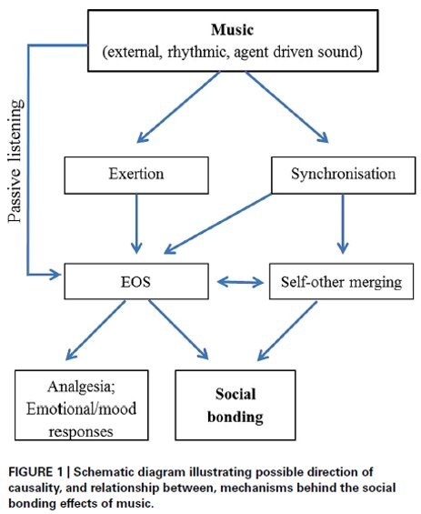
Why Does this Occur
Tarr et al. 2014

Slide 4
Antiphase Coordination and Prosocial Behavior
Evidence for antiphase prosocial behavior
Babies helping in antiphase condition(Cirelli et al., 2014)
Ratings of rapport(Miles et al., 2009)
Evidence against antiphase prosocial behavior
Null effects when tapping (Launay et al. 2013)

Slide 5
Research Questions
Does synchronous drumming cause more cooperation in cooperative games
Does asynchronous drumming cause similar effects as synchronous drumming
Is the degree of synchrony proportional to degree of cooperation

Slide 6
Variables
IV: Drumming
Synchronous
Asynchronous
Alone
DV: Cooperation
Cooperation Game
Trust Questionnaire
DV: Drumming
Hit onsets

Slide 7
Methods
4 x Synchronization Continuation Task: Alone
4 x Synchronization Continuation Task: Synchrony
Pre-drumming “cooperation game”
Post-drumming survey
Post-drumming “cooperation game”
4 x Synchronization Continuation Task: Alternating

Slide 8



Synchrony Trial
60 sec
8x
1000ms
1000ms
1000ms
1000ms
1000ms
1000ms
1000ms
1000ms
1000ms
1000ms
1000ms
1000ms
1000ms
1000ms
1000ms

Slide 9
Asynchrony Trial
60 sec
8x
500ms
500ms
500ms
1000ms
1000ms
1000ms
1000ms

Slide 10
Cooperation Game
 | Participant 1 Works Alone | Participant 1 Works Together
Participant 2 Works Alone | Both get a B $2.5 each | P1 gets a C, P2 gets a B P1: $0, P2: $2.5
Participant 2 Works Together | P1 gets a B, P2 gets a C P1: $2.5, P2: $0 | Both get an A $5 each
Notes:
“Pretend you are given an assignment for a major course project that you can either complete alone, or with the other partner completing this study with you. You will each decide whether you want to work alone or together. If you choose to work alone, you will be guaranteed a B on the assignment. If you choose to work with your partner, and your partner chooses to work with you, you will be given an A. If you choose to work with your partner, and they choose to work alone, you will be given a C. There may be multiple assignments, and you will not know what your partner chose until the end. Each person will receive a monetary reward based on the assignment grade(s).”

Slide 11
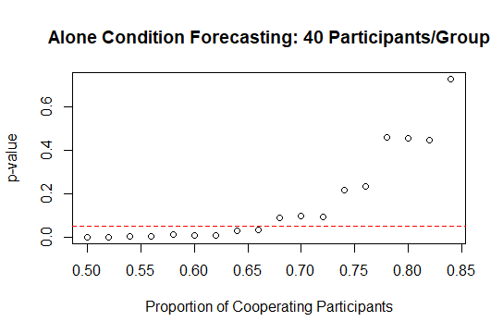
Simulation

Slide 12
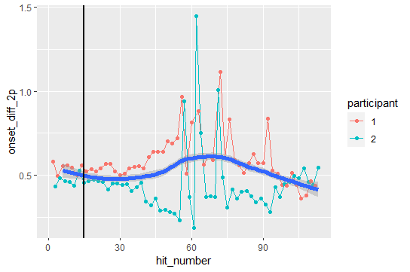
Analysis

Slide 13
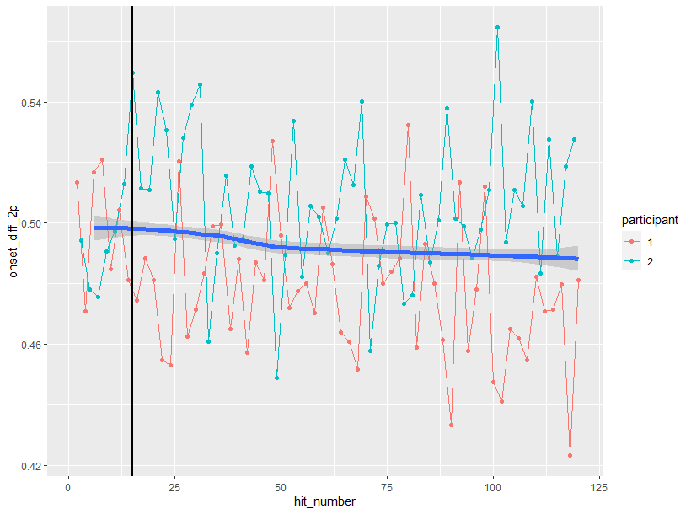
Analysis

Slide 14
Thank You
Any questions?

Slide 15
References
Cirelli, L. K., Einarson, K. M., & Trainor, L. J. (2014). Interpersonal synchrony increases prosocial behavior in infants. Developmental Science, 17(6), 1003–1011. https://doi.org/10.1111/desc.12193
Miles, L. K., Nind, L. K., & Macrae, C. N. (2009). The rhythm of rapport: Interpersonal synchrony and social perception. Journal of Experimental Social Psychology, 45(3), 585–589. https://doi.org/10.1016/j.jesp.2009.02.002
Mogan, R., Fischer, R., & Bulbulia, J. A. (2017). To be in synchrony or not? A meta-analysis of Synchrony’s effects on behavior, perception, cognition and affect. Journal of Experimental Social Psychology, 72, 13–20. https://doi.org/10.1016/j.jesp.2017.03.009
Tarr, B., Launay, J., & Dunbar, R. I. M. (2014). Music and social bonding: “Self-other” merging and neurohormonal mechanisms. Frontiers in Psychology, 5. https://www.frontiersin.org/articles/10.3389/fpsyg.2014.01096
Wiltermuth, S. S., & Heath, C. (2009). Synchrony and Cooperation. Psychological Science, 20(1), 1–5. http://www.jstor.org/stable/40065020

Slide 16
Hypotheses
Joint coordination is sufficient for social bonding (asynchronous and synchronous conditions shouldn’t differ)
Musical adaptation is the cause for social bonding

